Slide 1
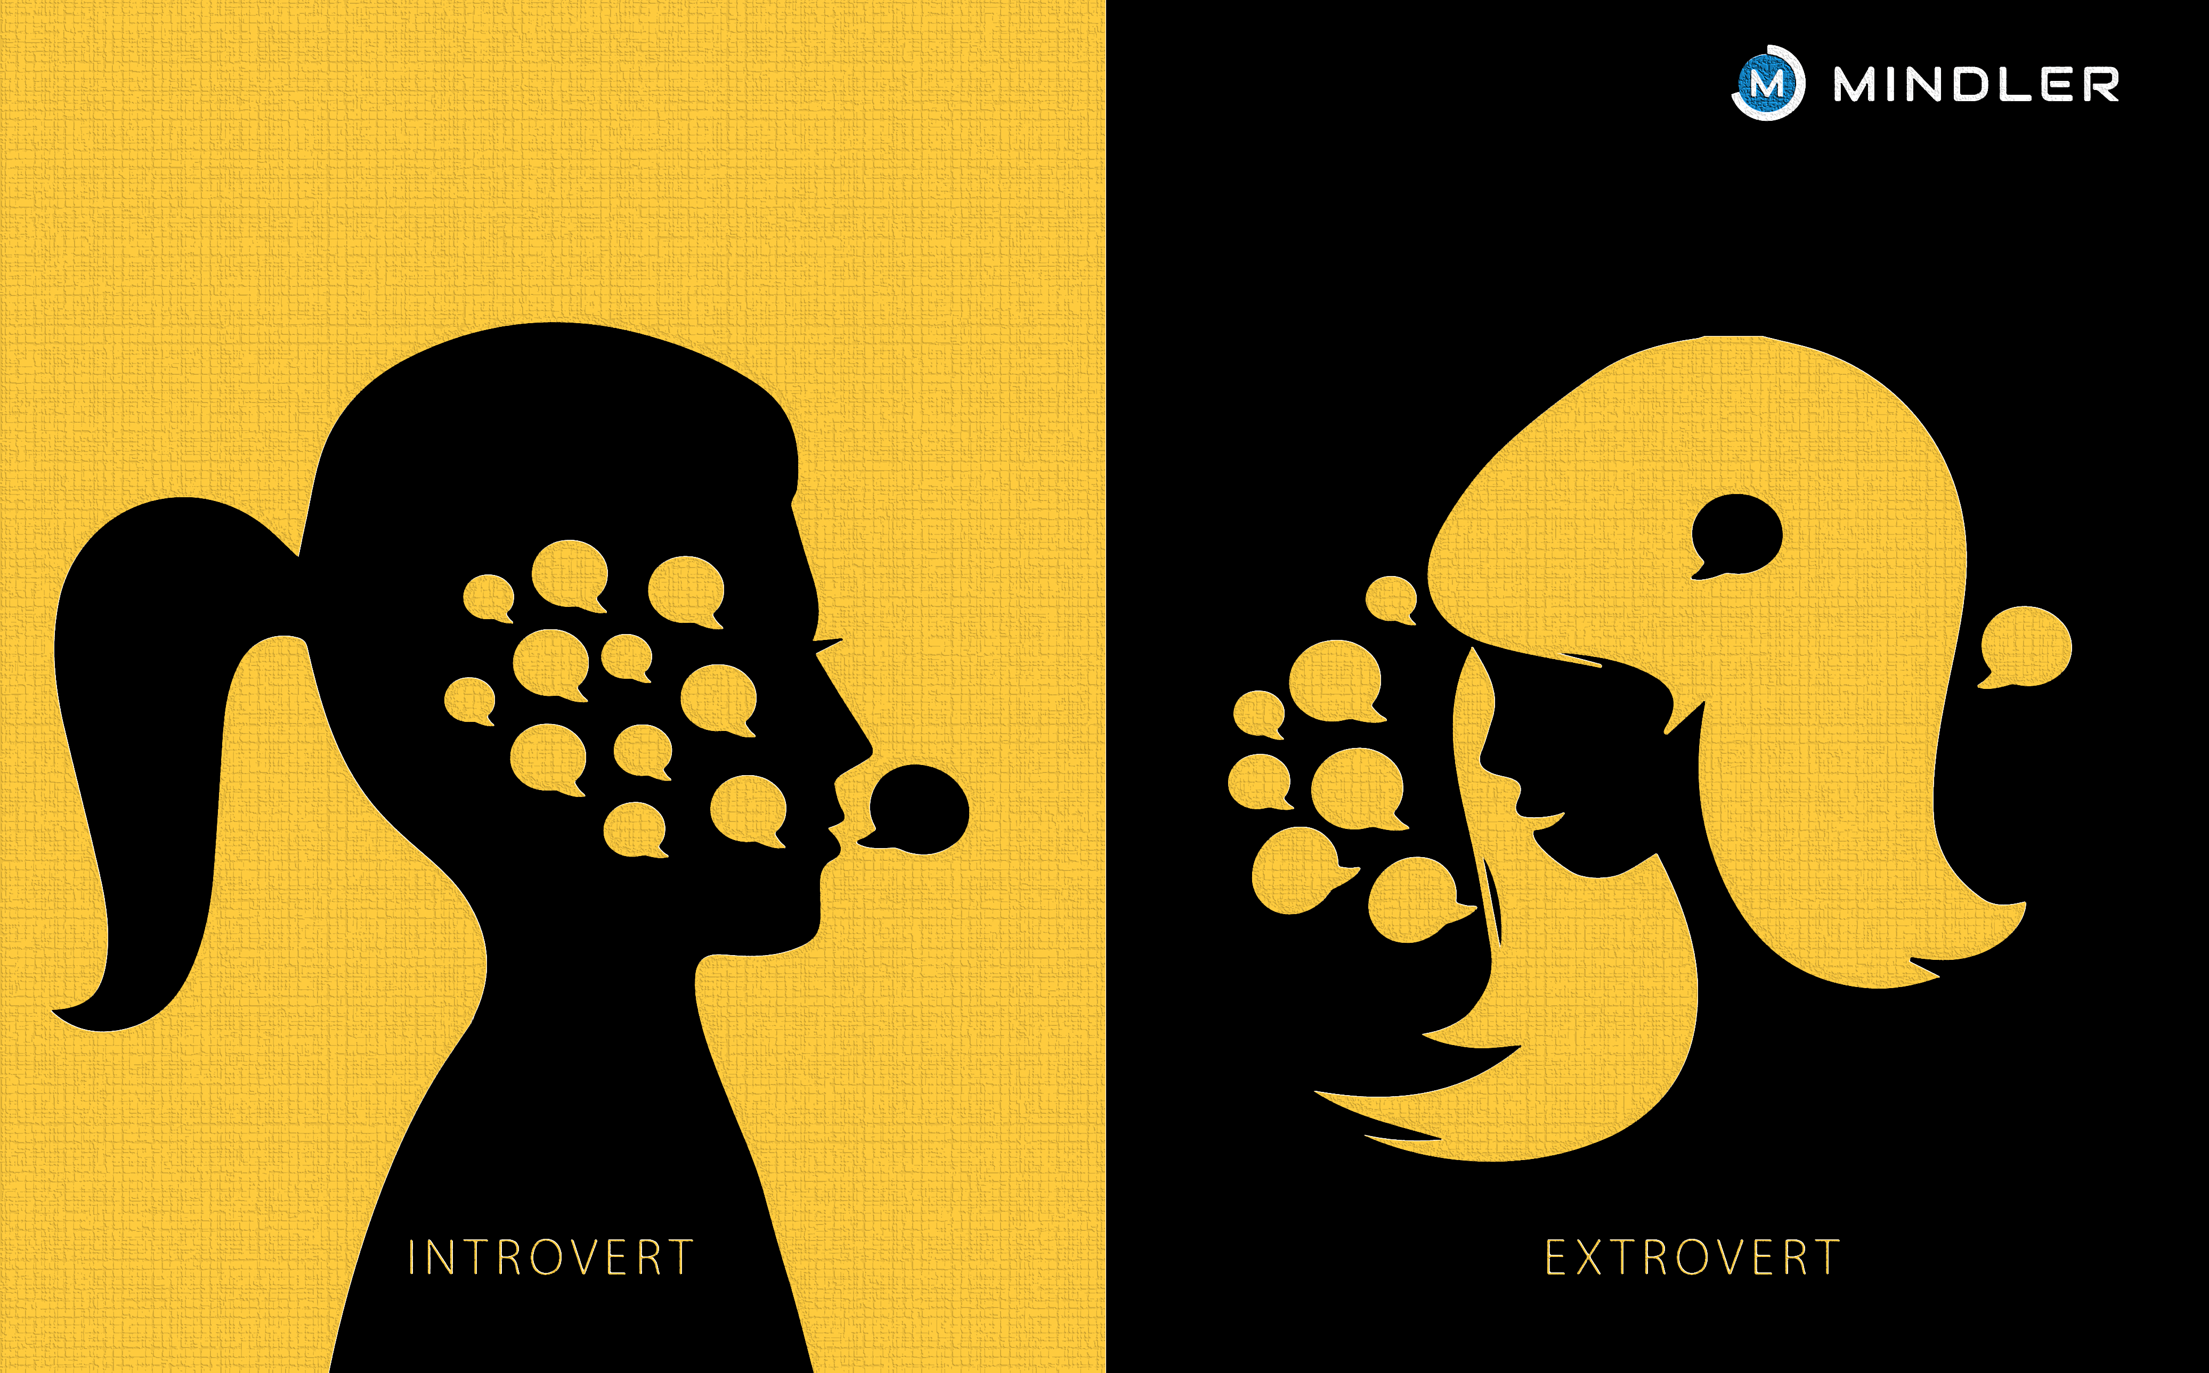
Psychological & Cognitive Networks: Introvert vs Extrovert
Submitted By:
Waseem Salami
Nadia Sirhan

Slide 2
Intro: what
Informative Background
The MBTI personality test distinguishes and classifies personalities based on four dichotomous dimensions:
Introversion (I) / Extroversion (E)
Intuition (N) / Sensing (S)
Thinking (T) / Feeling (F)
Judging (J) / Perceiving (P)
The two personality types we chose to focus on are:
ENFJ – Extroverted Intuitive Feeling Judging
INFJ – Introverted Intuitive Feeling Judging
It can be seen that these two personality types differ only in the first dimension, Introversion (I) / Extroversion (E). The reason we chose to compare these two types is that we are interested in examining the difference between semantic networks of introverted individuals compared to extroverted individuals. We are also interested in understanding the impact of introversion/extroversion on our personalities. We thought that if we take two individuals whose personalities are "similar" in every dimension except for the dimension of introversion/extroversion, we can more precisely separate and compare them, and also compare our results with the research findings based on this personality test.
Notes:
Waseem

Slide 3
Intro: what
Objective and Research Questions: Investigating the semantic structure of these two different personality subreddits raises several interesting research questions:
Primary Research Question:
How do the semantic networks of individuals with introverted personalities differ from the networks of individuals with extroverted personalities?
Secondary Research Questions:
How do the semantic networks of individuals with INFJ personalities differ from the networks of individuals with ENFJ personalities?
Does personality type influence the organization of the semantic network?
In all questions, it is also possible to incorporate a check for correlation with the findings of the MBTI research.
מטרה ושאלות מחקר:
חקירת מבני הרשת הסמנטית של שני סוגי האישיות השונות האלו מעלה מספר שאלות מחקר מעניינות:
שאלת מחקר ראשית: איך רשתות סמנטיות של אנשים בעלי אישיות מופנמת שונות מרשתות של אנשים בעלי אישיות מוחצנת?
Notes:
Waseem

Slide 4
Why analyze this phenomenon in networks?
Visualization: Network analysis provides a visual representation of the structure and relationships within semantic networks.
Quantitative measures: It offers quantitative metrics such as centrality or network density to understand the importance and connections of concepts.
Community detection: Network analysis can identify clusters of related terms within the networks.
Path analysis: It allows exploring paths between terms, illustrating how ideas are interconnected.
In summary, network analysis offers a unique combination of visualization, quantitative measures, and dynamic analysis, making it a powerful tool for investigating and comparing semantic networks.
Intro: why?
מטרה ושאלות מחקר:
חקירת מבני הרשת הסמנטית של שני סוגי האישיות השונות האלו מעלה מספר שאלות מחקר מעניינות:
שאלת מחקר ראשית: איך רשתות סמנטיות של אנשים בעלי אישיות מופנמת שונות מרשתות של אנשים בעלי אישיות מוחצנת?
Notes:
Waseem

Slide 5
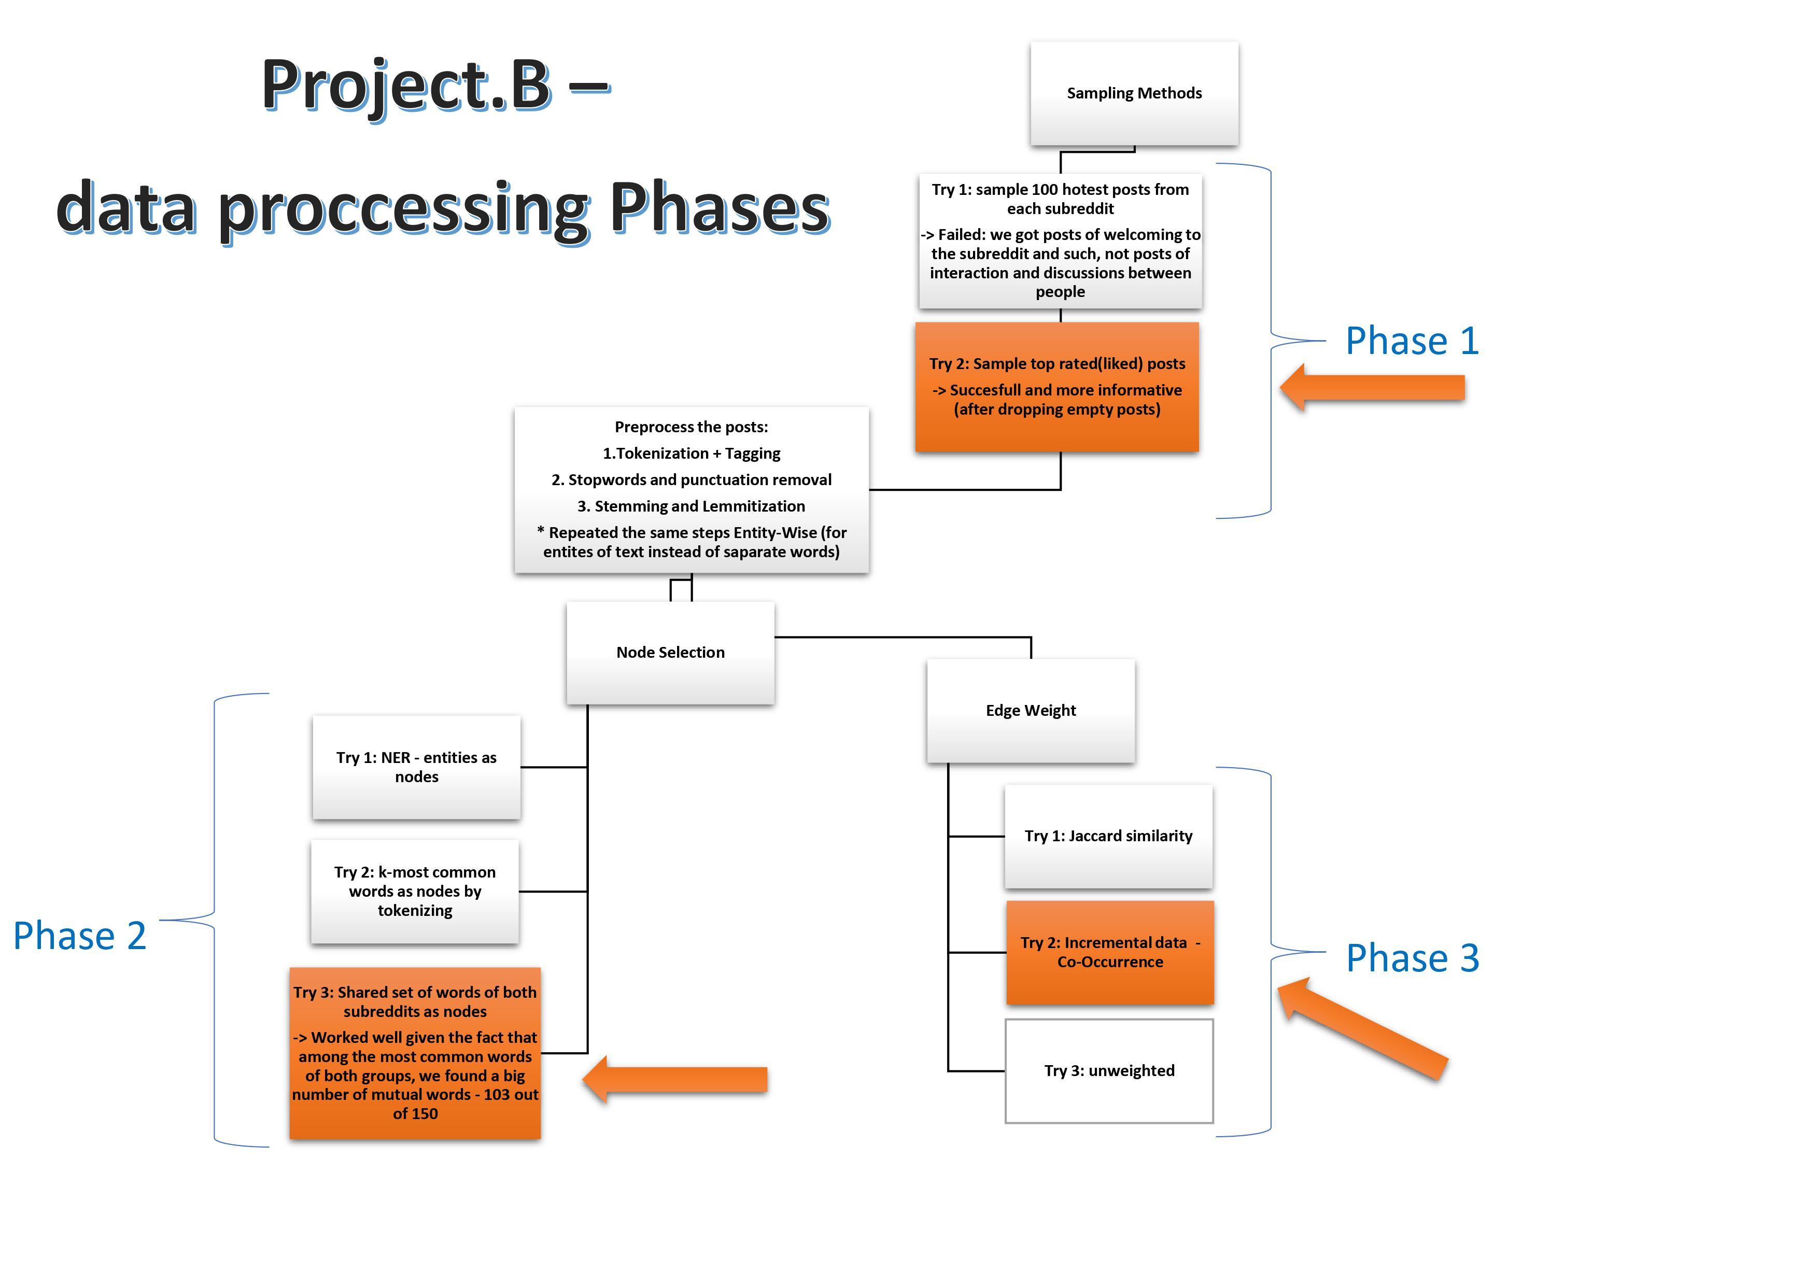
Intro: how?
מטרה ושאלות מחקר:
חקירת מבני הרשת הסמנטית של שני סוגי האישיות השונות האלו מעלה מספר שאלות מחקר מעניינות:
שאלת מחקר ראשית: איך רשתות סמנטיות של אנשים בעלי אישיות מופנמת שונות מרשתות של אנשים בעלי אישיות מוחצנת?
Notes:
Waseem

Slide 6
\
Creating the semantic networks:
We created our semantic network as follows:
Nodes: 77 mutual words after exploring the retrieved Reddit text from both subreddits, Interestingly enough - we got that out of 100 most common words of each subreddit, 77 were mutual! so we saw this as an opportunity to choose this set of words to be our nodes in order to examine the differences in the structure of the semantic networks which we will make based on these nodes.
Edges: edges in the graph are in the form of : (word1, word2, Co-Occourence of word1 and word2)
meaning that we defined weight of two words to be the Co-Occourence(number of times both words appeared in the same entity)
Notes:
Nadia

Slide 7
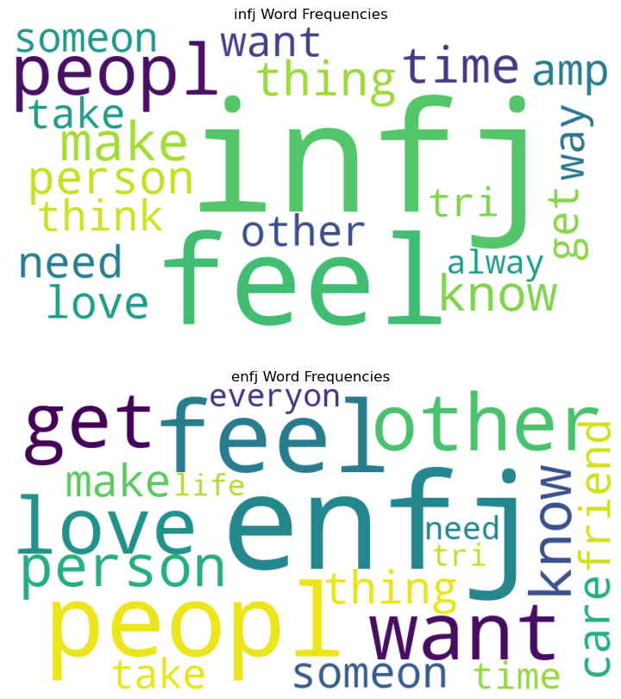
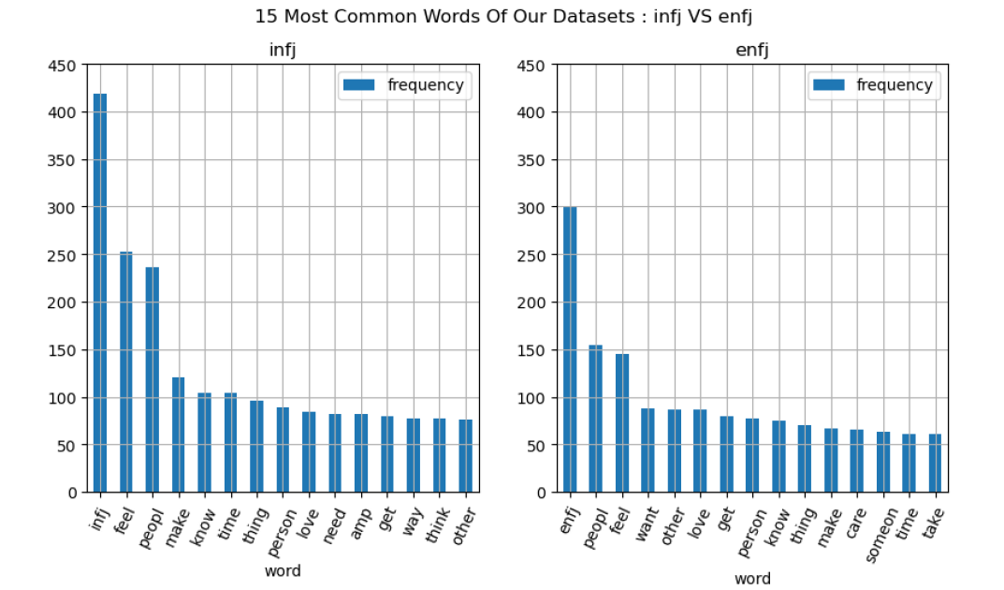
Notes:
Nadia

Slide 8
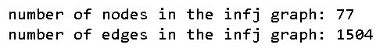
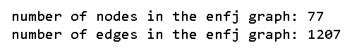
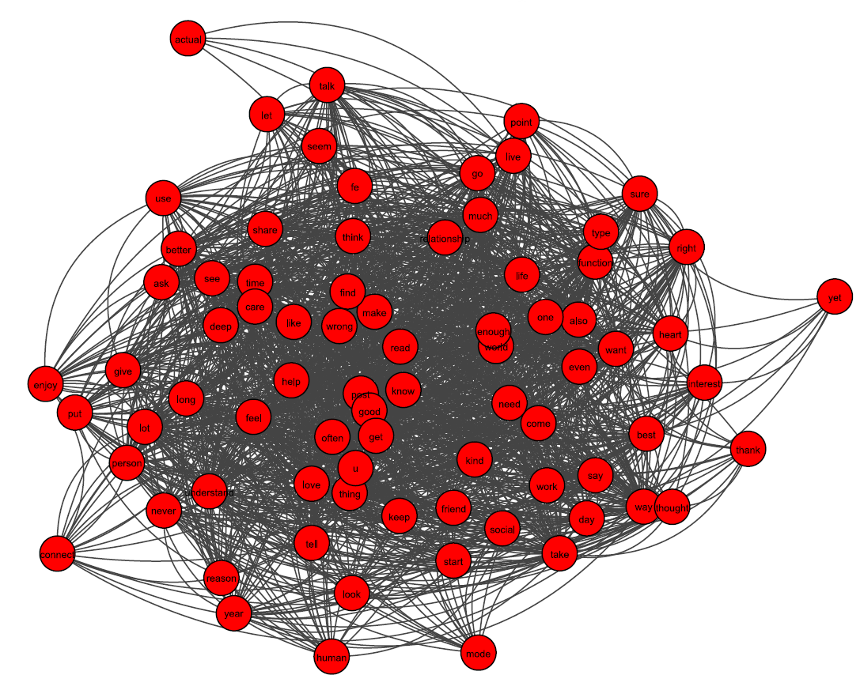
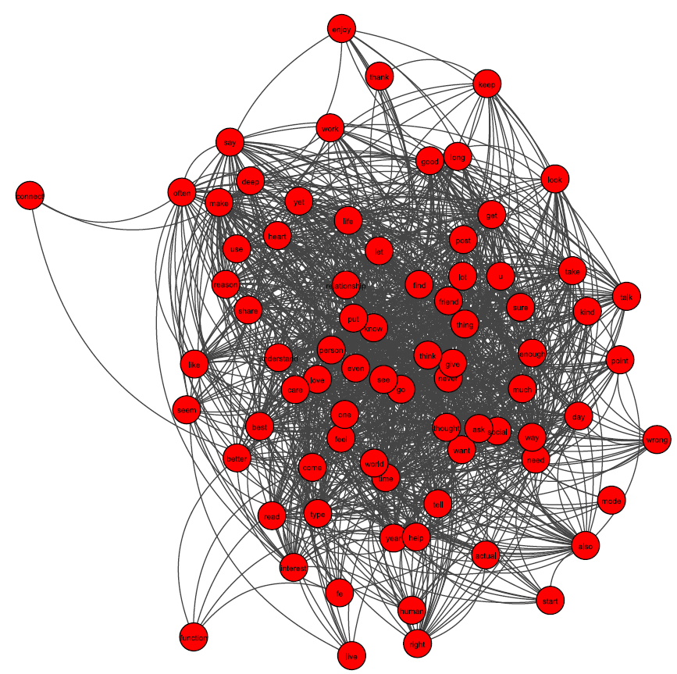
infj semantic network
enfj semantic network
Notes:
Nadia

Slide 9
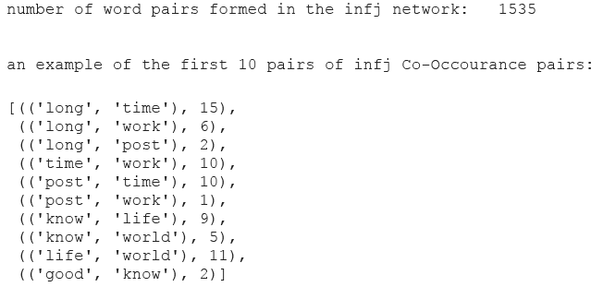
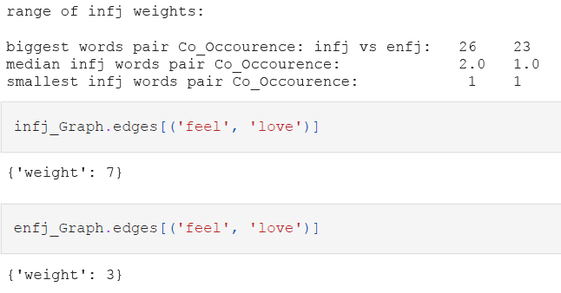
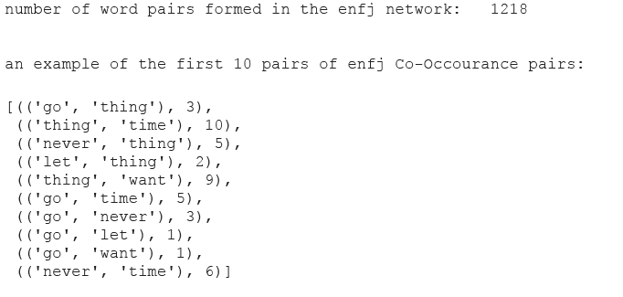
Statistics on our semantic networks
Notes:
Waseem

Slide 10
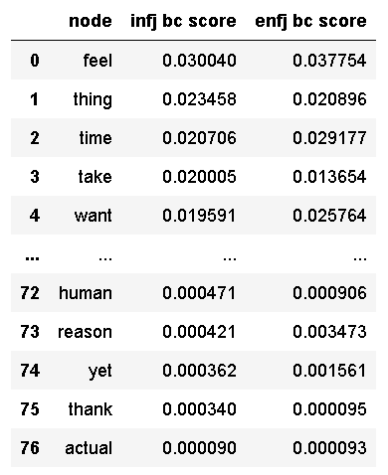
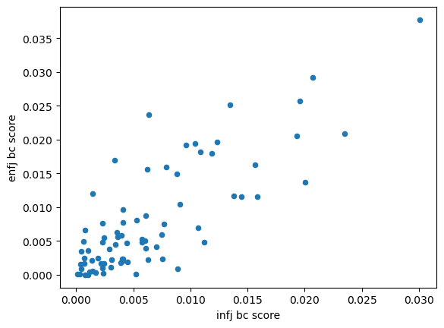
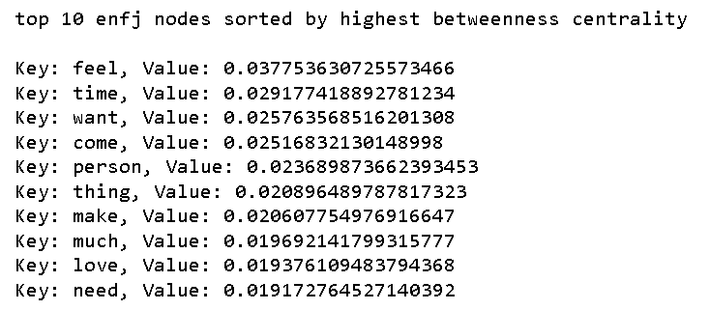
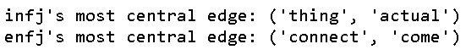
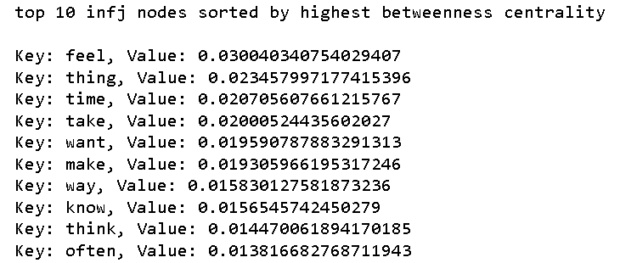
Analyzing the semantic networks Network Measurements:
t-statistic of the betweness centrality: infj vs enfj: -1.292254
p-value of the betweness centrality:
infj vs enfj: 0.198230
Correlation of the betweness centrality:
infj vs enfj: 0.806170
betweenness centrality:
Notes:
Waseem

Slide 11
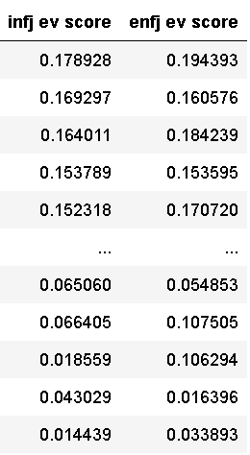
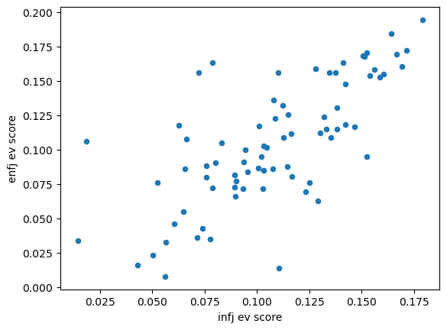
Analyzing the semantic networks Network Measurements:
t-statistic of the eigenvector centrality: infj vs enfj: 0.452380
p-value of the eigenvector centrality:
infj vs enfj: 0.651639
Correlation of the eigenvector centrality:
infj vs enfj: 0.716519
eigenvector centrality:
Notes:
Waseem

Slide 12
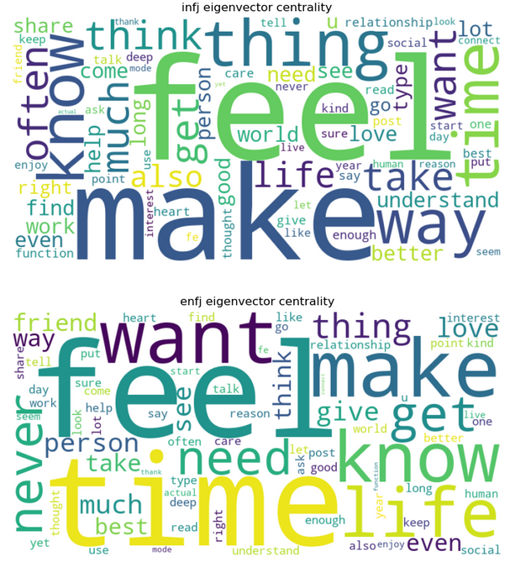
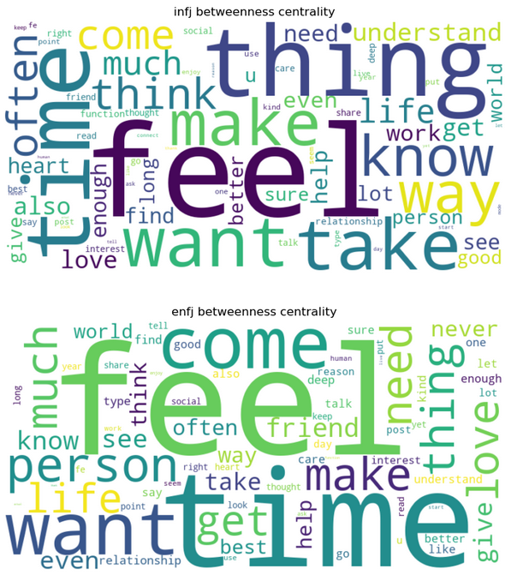

Slide 13
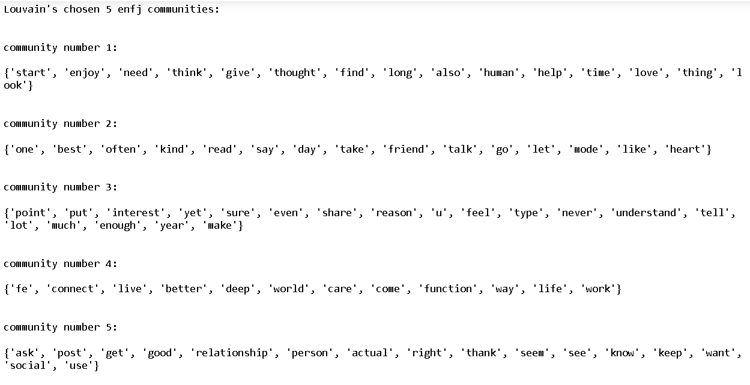
Community detection
Tried several algorithms, mainly the Girvan Newman Algorithm and the Louvain Algorithm, the algorithm that obtained best Modularity score was the Louvain Algorithm, so we chose it for community detection.
Notes:
Nadia

Slide 14
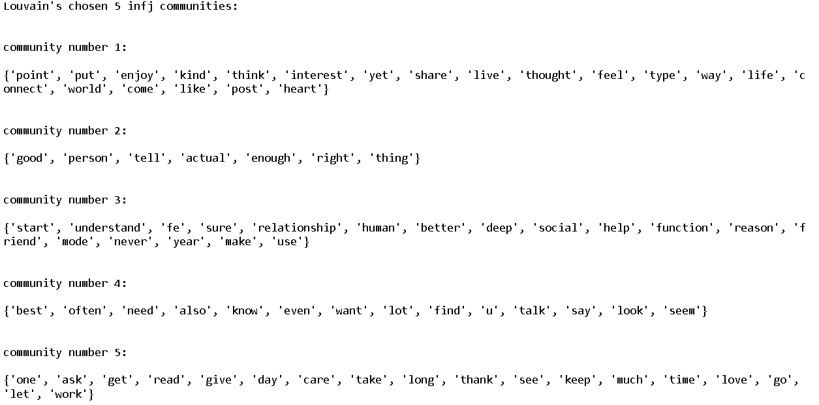
Notes:
Nadia

Slide 15
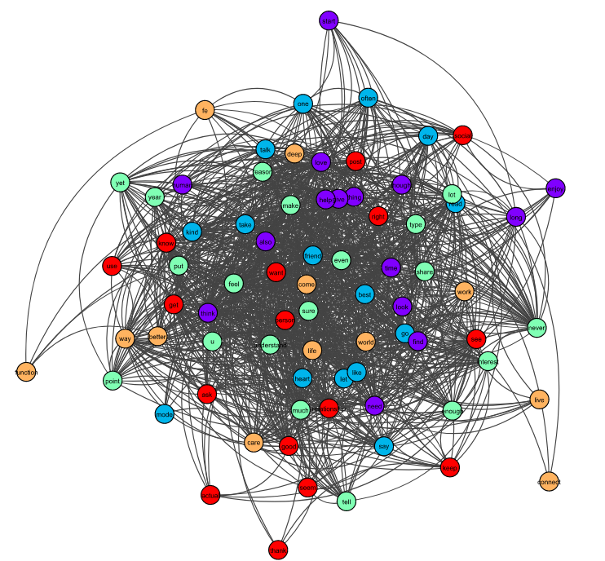
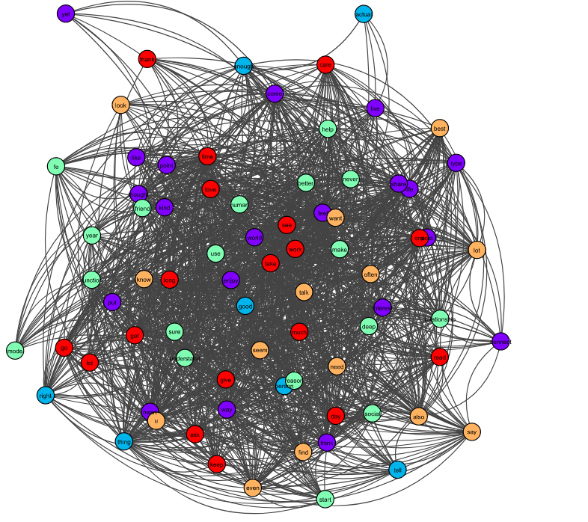
infj Communities
enfj Communities
Notes:
Nadia

Slide 16
Conclusions
For both of our groups: infj which represents the introverts and enfj which represents the extroverts, we tried several approaches to compare their semantic networks, we compared their most common words, we compared their metrics such as the betweenness and eigenvector centrality both in word-to-word score comparison and in t-tests and statistics, we also tried to detect communities within each group and compare them
-> from all these comparisons we inferred that we reject our null hypothesis: introverts and extroverts have relatively-similar semantic networks, which in our opinion is also an interesting direction to test.
Notes:
Nadia

Slide 17
Future Steps
To gain more insights, we can conduct the following steps:
Time-based Analysis: we can conduct a temporal analysis. Where we look at how the semantic networks of introverts and extroverts evolve over time. This could reveal interesting dynamic features in the data.
Node-level Analysis: we can do a more detailed analysis at the node level. Which nodes (words) are more central or peripheral in each group's network? How do these 'key' nodes differ between the groups? And other questions my pop-up.
Incorporate External Data: we thought about bringing in external data related to the words in our network. This might include psychological scales or measures that relate to the words in our network, which could provide additional context or information, e.g. sentiment analysis.
Notes:
Waseem

Slide 18
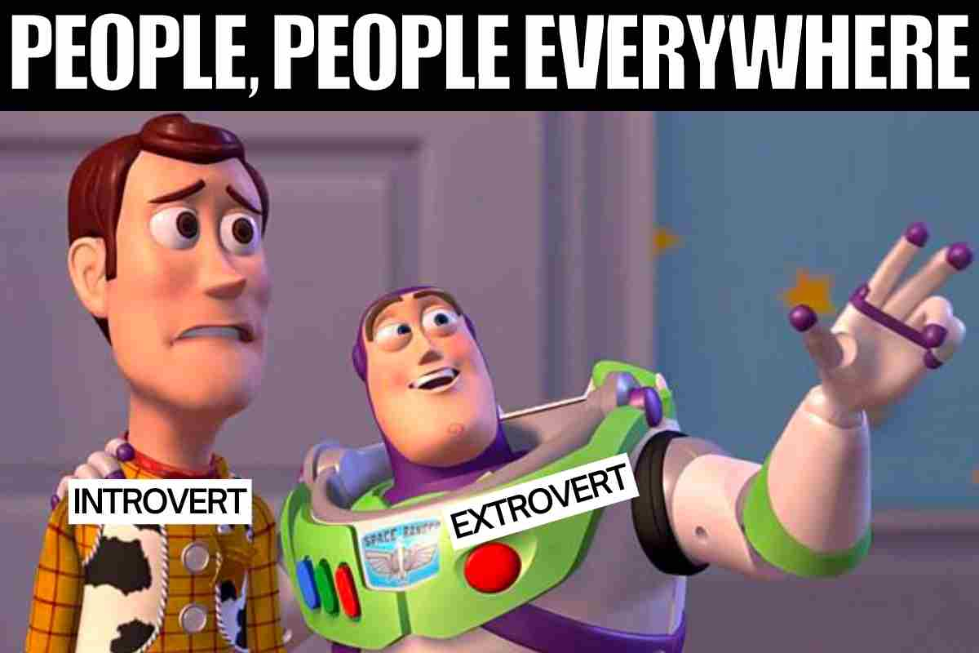
Thank you for listening!
And thank you for an awesome course.

